Slide 1
Dr. Umayal Ramanathan College for Women, Karaikudi. Accredited with B+ Grade by NAAC Affiliated to Alagappa University
Class: III B.Sc., Electronics and Communication
7BEC5C1C
Optical Communication
Dr. K.Punitha
Assistant Professor,
Department of Physics & EC
Dr. URCW

Slide 2
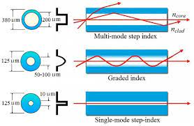
Wave propagation in single index fiber and Graded index fiber

Slide 3
Based on the refractive index of core medium, optical fibers are classified into two categories
i. Step index fiber
ii. Graded index fiber
Based on the number of modes of transmission, optical fibers are classified into two categories
i. Single mode fiber
ii. Multi mode fiber
STEP INDEX FIBER:
In step index fibers, the refractive index of the core medium is uniform and undergoes an abrupt change at the interface of core and cladding. The diameter of the core is about 10 micrometers in single mode fibre and 50 to 200 micrometers in case of multimode fiber.
Wave propagation:
Let us consider a cylindrical fibre with core and cladding. The fiber is placed in the air medium. Let the refractive index of the core be n₁ and the refractive index of the cladding be n₂. the refractive index of the air medium is n₀. Also FF’ be the fibre axis.

Slide 4
A light ray travels along AO in the air medium and falls on the surface of the core at an angle θ₀ with the fibre axis FF’.
OB is the refracted ray in the core medium of refractive index n₁. The angle of refraction is θ₁. θ₁ < θ₀, since the core is denser medium.
The refracted ray OB falls on the interface between the core and cladding. OB makes an angle θ_{c} with the normal NN’ where, θ_{c} = 90 – θ₁.
Now the ray travels along BC, i.e. angle made by the ray BC with the normal is 90°. So the angle θ_{c} is said to be the critical angle.
Acceptance
cone
n₂ Cladding
A′
θ_{c}
Reflected ray
θ₁
n_{a} < n₁
O
θ₀
n₁ Core
n₂ Cladding
A
Entrance rays

Slide 5
Let another ray A’O falls on the surface of the core. This ray makes an angle less than θ₀ (< θ₀) with the fibre axis FF’. It is then refracted inside the core and falls on XX’ at an angle greater than the critical angle. Thus the light ray is totally reflected internally.
If any ray falls on the surface of the core at an angle greater than θ₀, then it is refracted into the cladding. Hence it will be lost by absorption. Thus the ray having the incident angle < θ₀ on either side of the fibre axis FF’ will be undergoing total internal reflection.
Draw a cone connecting these two rays AO and A’O. this cone is said to the acceptance cone. The angle made by the ray AO with FF’ is said to be acceptance angle.
Hence the angle θ₀ is the maximum angle at which the light ray just enters the core for which the total internal reflection at core cladding interface. This angle θ₀ is called acceptance angle.
Acceptance angle: The maximum angle at which the light enters the core for which the total internal reflection just occurs at the core-cladding interface is called acceptance angle.

Slide 6
By applying Snell’s law of refraction at O,
Refractive index of the core with respect to air
At the interface between core and cladding.
Refractive index of core with respect to cladding
sin i
n₁ =
sin r
n₁
since qn₁ =
n₀
n₁
sin q₀
=
i = q₀ and r = q₁
n₀
sin q₁
n₁
n₀sin q₀ = n₁ sin q₁ (or) sin q₀ =
sin q₁ ------ (1)
n₀
n₁
sin 90
n₁
=
=
n₂
sin (90 – q₁)
n₁
1
n₂
=
or
=
sin (90 – q₁) = cos q₁ ------ (2)
n₂
sin (90 – q₁)
n₁

Slide 7
We know that
Applying eq. (4) in eq. (1) we get,
If the optical fibre is placed in air medium, then n0 = 1. Then eq. (5) becomes,
sin²θ₁ + cos²θ₁ = 1
sin²θ₁ = 1 - cos²θ₁
sin q₁ = √(1-cos²q₁) ------- (3)
sin q₁ = √1-(n₂²/n₁²)
sin q₁ = √((n₁²-n₂²)/n₁² ) ----- (4)
n₁
n₁
sin q₀ =
sin q₁ =
√((n₁²-n₂²)/n₁² )
n₀
n₀
n₁
√(n₁²-n₂²)
sin q₀ =
=
√(n₁²-n₂²)/n₀
n₀
n₁
q₀ = sin⁻¹
√(n₁²-n₂²)
-------- (5)
n₀
q₀ = sin⁻¹
√(n₁²-n₂²) --------- (6)

Slide 8
The light entering the core from within the cone defined by the acceptance angle will be guided to travel through the optical fibre. This is the principle of light propagation through an optical fibre.
Numerical aperture (NA):
the sine of acceptance angle of the fibre is called Numerical aperture (NA). It represents the light gathering power of the optical fibre.
Numerical aperture NA = sin θ₀.
If the surrounding medium is air, then n0 = 1. The above eq. becomes
Let θ1 be the angle of incidence for the ray entering the core. The light ray will be propagated if,
This is the condition for the propagation of light inside the fibre.
√(n₁²-n₂²)
NA = sin (q₀) =
n₀
NA = √(n₁²-n₂²) ---------- (7)
θ_{i} < θ₀ (or) sin θ_{i} < sin θ₀ (or) sin θ_{i} < √(n₁²-n₂²)
sin θ_{i} < NA

Slide 9
SINGLE MODE FIBRES:
In the single mode fibres, the diameter of the core is very small of the order of 5 to 10 μm. So it allows only one mode of propagation of light waves. Hence it is called “single mode fibre”. In this mode, light travels along a single path, along the axis. The diameter of the cladding is very large of the order of 125 μm when compared with the diameter of the core.
Intermodal dispersion does not exist in single mode fibre because only one mode exists. Hence this type of fibre can be used for long distance communication.
MULTIMODE FIBRES:
The diameter of the core is 50 to 350 μm and allows many modes of propagation of light waves. Hence, it is called as “multimode fibre”. The diameter of the cladding is also very large.
As a result, light travels in zig-zag paths. The numerical aperture of the multimode fibre is larger as the core diameter is larger. Larger numerical aperture leads to more modes which also means higher dispersion. This is useful in short distance communication.

Slide 10
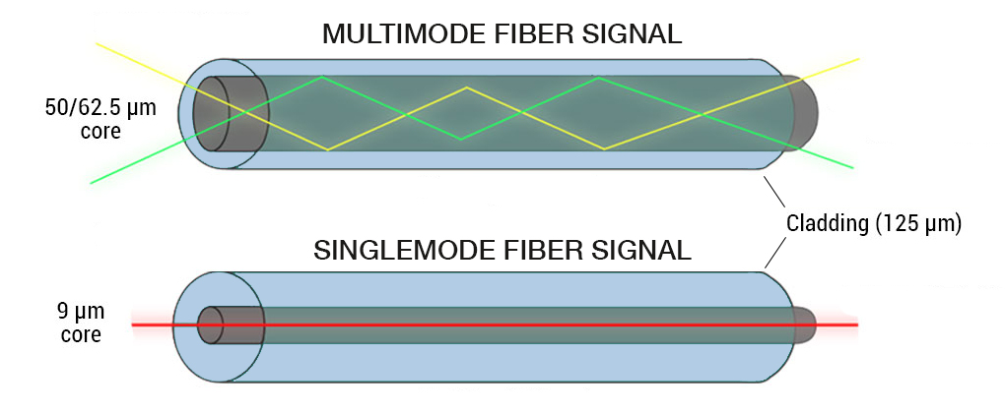

Slide 11
STEP INDEX FIBRE:
The core of the optical fibre has uniform refractive index n1 and the cladding also has uniform refractive index n2 where, n1 > n2. Let a and b the radii of core and cladding respectively.
The refractive index changes abruptly at the core-cladding interface and the refractive index profile is in the shape of a step. Hence, this fibre is called “step index fibre”.
The two rays travel with different path lengths and emerge out at different times. It means that an input pulse gets broadened. This is called intermodal dispersion.
Intermodal dispersion imposes limitation on the separation between pulses thereby reducing the transmission rate and capacity.

Slide 12
GRADED INDEX FIBRE:
If the core has a non-uniform refractive index that gradually decreases from the centre towards the core-cladding interface, the fibre is called “graded index fibre”.
It is obvious from the figure that the ray is continuously bent and travels a periodic path along the axis. The rays entering at different angles follow different paths with the same period both in space and time.
There is also a periodic self focusing of the rays. It should be noted that pulse dispersion is less as compared with the step index fibre. Thus, the problem of intermodal dispersion can be overcome using graded index fibre.

Slide 13
TRANSMISSION OF SIGNAL IN STEP INDEX FIBRE:
Generally, the optical signal is transmitted through the fibre in the digital form, ie. in the form of 0’s and 1’s. the transmitted optical signal will cross the fibre axis during every reflection at the core cladding interface. The shape of propagation of the optical signal is zigzag manner. Generally, the signal through the fibre is in digital form ie. in the form of pulses representing 0s and 1s.
In figure, the ray 1 follows the shortest path ie. it travels along the axis of fibre. The ray 2 follows longer path than ray 2. hence, the two rays reach the receiver end at different times. Therefore, the pulsed signal at the receiver end gets broadened. This is called intermodal dispesion. This can be overcome in graded index fibre.

Slide 14
TRANSMISSION OF SIGNAL IN GRADED INDEX FIBRE:
The shape of the propagation in graded index fbre is in helical or spiral manner.
The transmitted optical signal will never cross the fibre axis during every reflection at the core cladding interface.
Ray 1 is travelling along the axis of the core and the other ray 2 is travelling away from the axis undergoes refraction and bent. Since, ray 2 is travelling in the lesser refractive index medium, ray 2 moves slightly faster than ray 1. Hence the two rays reach the other end simultaneously. Thus the problem of intermodal dispersion can be overcome.

Slide 15
TYPES OF MODES
Guided modes are those with intensity distributions limited to the core and its immediate vicinity. Their field distributions decay exponentially in the cladding. Guided modes normally exhibit rather small propagation losses.
Leaky modes are those which are concentrated around the core but lose some power into the cladding.
Cladding modes have intensity distributions that essentially fill the full cladding region, thus also reaching the outer surface of the cladding, where they often experience large power losses. The intensity in the fiber core is substantial for some cladding modes but very small for others.

