Slide 1
APPLIED ELECTRONICS – I
(ANALOG, DIGITAL AND COMMUNICATION ELECTRONICS)
Course code -7BELA3
Year- II YEAR – III SEMESTER
Department- Electronics and Communication
Dr. A. S. ENIGOCHITRA
Assistant Professor, Dept. of Physics & EC

Slide 2
Unit – I
Diode and Its Applications

Slide 3
Diode
“Di “= Two, and “Ode “= Electrodes i.e a device or component having two electrodes viz Anode “+” (P) and Cathode “-” (N)
A diode is a two-terminal unidirectional power electronics device.
The semiconductor diode is the first invention in a family of
semiconductor electronics devices.
Generally, silicon is used to make a diode. But another semiconductor material like germanium or germanium arsenide is also used.
A diode allows current to flow only in one direction and it blocks the current in another direction. It offers low resistance (ideally zero) in one direction and it offers a high resistance (ideally infinite) in another direction.

Slide 4
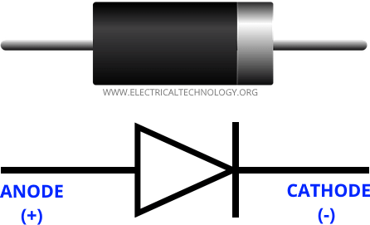
Symbol of Diode

Slide 5
Construction of Diode
semiconductor material
Intrinsic Semiconductor
(A pure semiconductor in which hole and electrons are available in equal numbers at room temperature)
Extrinsic Semiconductor
(In an extrinsic semiconductor, impurities are added to increase the number of holes or the number of electrons)

Slide 6
Construction cont…..
A semiconductor diode has two layers. One layer is made of a P-type semiconductor layer and the second layer is made of an N-type semiconductor layer.
If we add trivalent impurities in silicon or germanium, a greater number of holes are present and it is a positive charge. Hence, this layer is known as the P-type layer.
If we add pentavalent impurities in silicon or germanium, a greater number of electrons are present and it is a negative change. Hence, this layer is known as the N-type layer.
The diode is formed by joining both N-type and P-type semiconductors together. This device is a combination of P-type and N-type semiconductor material hence it is also known as PN Junction Diode.

Slide 7
Cont…
A junction is formed between the P-type and N-type layers. This junction is known as PN junction.
A diode has two terminals; one terminal is taken from the P-type layer and it is known as Anode. The second terminal is taken from the N-type material and it is known as Cathode.

Slide 8
Working of Diode
In the N-type region, electrons are the majority charge carriers and holes are
minority charge carriers.
In the P-type region, the holes are majority charge carrier and the electrons are negative charge carriers.
Because of the concentration difference, majority charge carriers diffuse and recombine with the opposite charge. It makes a positive or negative ion.
These ions are collected at the junction. And this region is known as the depletion region.

Slide 9
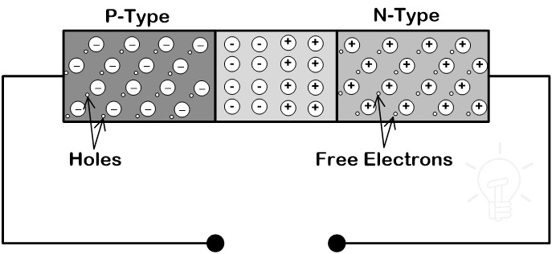
Working of Diode
When anode terminal of diode is connected with a negative terminal and cathode is connected with the negative terminal of a battery, the diode is said to be connected in reverse bias.
Similarly, when anode terminal is connected with a positive terminal and cathode is connected with the negative terminal of the battery, the diode is said to be connected in forward bias.

Slide 10
Operating regions
Zero Bias
No external voltage is applied to the PN junction diode
Forward Bias
The voltage potential is connected positively to the P- type terminal and negatively to the N-type terminal of the Diode.
Reverse Bias
The voltage potential is connected negatively to the P-type terminal and positively to the N-type terminal of the Diode.

Slide 11
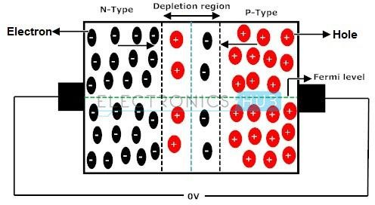
PN Junction Diode When No External Voltage is Applied
A net zero current flows in the circuit and the junction is said to be in
dynamic equilibrium.
In general no conduction of electric current takes place because no external source is connected to the PN junction.

Slide 12
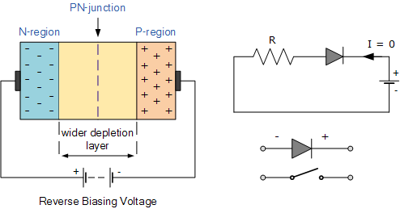
Reverse Biased PN Junction Diode-
Increase in the Depletion Layer due to Reverse Bias
When a diode is connected in a Reverse Bias condition, a positive voltage is applied to the N-type material and a negative voltage is applied to the P-type material.
The positive voltage applied to the N-type material attracts electrons towards the positive electrode and away from the junction, while the holes in the P-type end are also attracted away from the junction towards the negative electrode.
The net result is that the depletion layer grows wider due to a lack of electrons and holes and presents a high impedance path, almost an insulator. The result is that a high potential barrier is created thus preventing current from flowing through the semiconductor material.

Slide 13
Forward Biased PN Junction Diode- Reduction in the Depletion Layer due to Forward Bias
When a diode is connected in a Forward Bias condition, a negative voltage is applied to the N-type material and a positive voltage is applied to the P-type material.
If this external voltage becomes greater than the value of the potential barrier, approx. 0.7 volts for silicon and 0.3 volts for germanium, the potential barriers opposition will be overcome and current will start to flow.
This is because the negative voltage pushes or repels electrons towards the junction giving them the energy to cross over and combine with the holes being pushed in the opposite direction towards the junction by the positive voltage.
This results in a characteristics curve of zero current flowing up to this voltage point, called the “knee” on the static curves and then a high current flow through the diode with little increase in the external voltage as shown below.

Slide 14
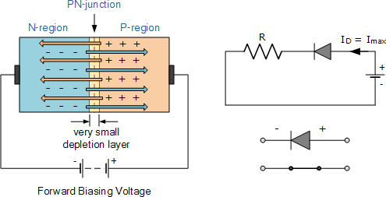
Reduction in the Depletion Layer due to Forward Bias

Slide 15
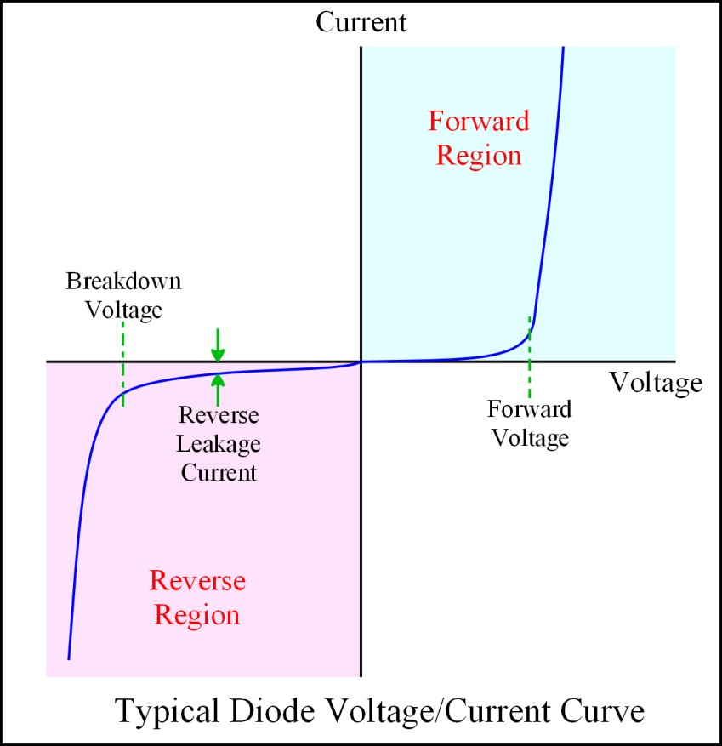
V-I Characteristics of P-N Junction Diode
In the current–voltage characteristics of junction diode, from the first quadrant in the figure current in the forward bias is incredibly low if the input voltage applied to the diode is lower than the threshold voltage (Vr). The threshold voltage is additionally referred to as cut- in voltage.

Slide 16
Zener Diode
A zener diode is a special type of diode that is designed to operate in the reverse breakdown region.
An ordinry diode operated in this region will usually be destroyed due to excessive current.
The Zener diode is heavily doped to reduce the reverse breakdown voltage
This causes the very thin depletion layer
As a result the Zener diode has a sharp reverse breakdown voltage Vz. Two things
will happen when Vz is reached
The diode current increases rapidly
The reverse voltage Vz across the diode remains almost constant.

Slide 17
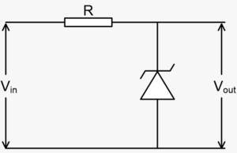
Symbol of Zener Diode
VI characteristic of Zener Diode
Circuit of Zener diode

Slide 18
References
Principles of Electronics, V.K. Metha, S.Chand & Co Ltd.
https://www.elprocus.com/p-n-junction-diode- theory-and-working/
https://www.electronicshub.org/characteristics-and- working-of-p-n-junction-diode/

