Slide 1
Dr.Umayal Ramanathan College for Women, Karaikudi
Department of Biotechnology
COURSE CODE: 7BBT4C1
CORE COURSE - VII – PRINCIPLES OF GENETICS
Unit - I
Mendelian Principles: Domination, segregation, independent assortment, deviation from Mendelian inheritance. Genotype & phenotype.
Prepared By:
Dr. J. Chitra

Slide 2
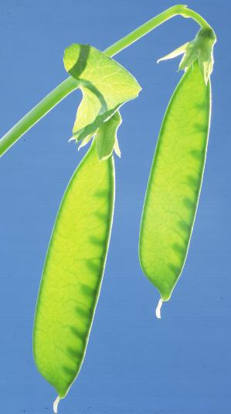
GENETICS
Introduction to Genetics and heredity
Gregor Mendel – a brief bio
Genetic terminology (glossary)
Monohybrid crosses
Patterns of inheritance
Dihybrid crosses
Test cross
Beyond Mendelian Genetics – incomplete dominance

Slide 3
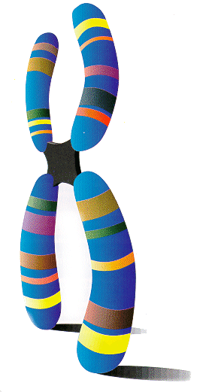
Introduction to Genetics
GENETICS – branch of biology that deals with heredity and variation of organisms.
Chromosomes carry the hereditary information (genes)
Arrangement of nucleotides in DNA
DNA → RNA → Proteins

Slide 4
Chromosomes (and genes) occur in pairs Homologous Chromosomes
New combinations of genes occur in sexual reproduction
Fertilization from two parents

Slide 5
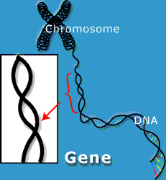
Genetics terms you need to know:
Gene – a unit of heredity; a section of DNA sequence encoding a single protein
Genome – the entire set of genes in an organism
Alleles – two genes that occupy the same position on homologous chromosomes and that cover the same trait (like ‘flavors’ of a trait).
Locus – a fixed location on a strand of DNA where a gene or one of its alleles is located.

Slide 6
Homozygous – having identical genes (one from each parent) for a particular characteristic.
Heterozygous – having two different genes for a particular characteristic.
Dominant – the allele of a gene that masks or suppresses the expression of an alternate allele; the trait appears in the heterozygous condition.
Recessive – an allele that is masked by a dominant allele; does not appear in the heterozygous condition, only in homozygous.

Slide 7
Genotype – the genetic makeup of an organisms
Phenotype – the physical appearance
of an organism (Genotype + environment)
Monohybrid cross: a genetic cross involving a single pair of genes (one trait); parents differ by a single trait.
P = Parental generation
F₁ = First filial generation; offspring from a genetic cross.
F₂ = Second filial generation of a genetic cross

Slide 8
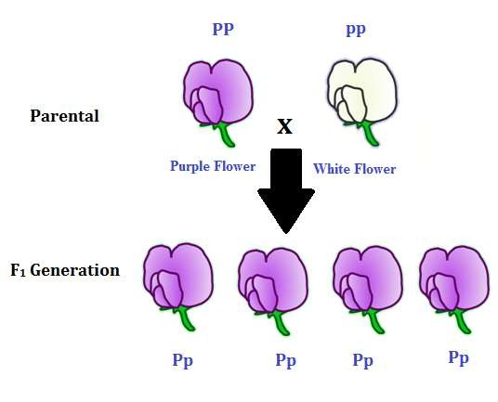
Dominant allele: An allele that masks the presence of a recessive allele in the phenotype. Dominant alleles for a trait are usually expressed if an individual is homozygous dominant or heterozygous.
Recessive alleles: An allele that is masked in the phenotype by the presence of a dominant allele. Recessive alleles are expressed in the phenotype when the genotype is homozygous recessive
The uppercase letters are used to denote dominant alleles, whereas the
lowercase letters are used to denote recessive alleles.

Slide 9
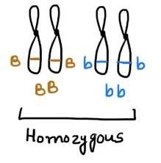
Homozygous: Having the same allele at the same locus on pair of homologous chromosomes. Homozygous also refers to a genotype consisting
of two identical alleles of a gene for a particular trait. homozygous for a trait are referred to as homozygotes.
Individuals who are

Slide 10
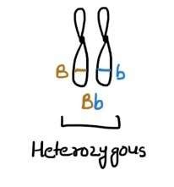
Heterozygous : A genotype consisting of two different alleles of a gene for a particular trait (Bb). Individuals who are heterozygous for a trait are referred to as heterozygotes.

Slide 11
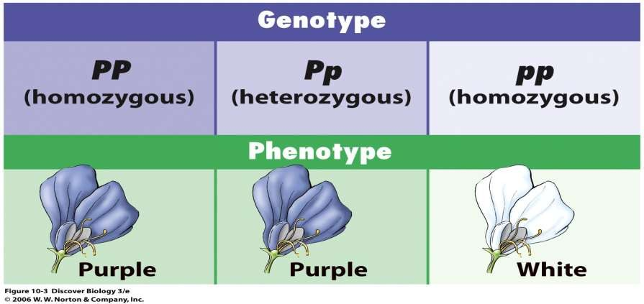
Genotype refers to an individual's the "genetic potential": what kind of genes
s/he carries.
Phenotype (from the Greek "pheno" meaning "to show") refers to the traits an
individual actually shows.

Slide 12
Hybrid offspring that are the result of mating between two genetically different kinds of parents
F₁ generation the first offspring (or filial) generation. The next and
subsequent generations are referred to as F_{2,} F₃ etc.
Monohybrid cross is a cross between parents differing in only one trait or in
which only one trait is being considered.
Dihybrid cross is a cross between parents in which two pairs of contrasting characters are studied simultaneously for the inheritance pattern.

Slide 13
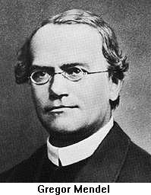
Gregor Johann Mendel
Austrian Monk, born in what is now Czech Republic in 1822
Son of peasant farmer, studied Theology and was ordained priest Order St. Augustine.
Went to the university of Vienna, where he studied botany and learned the Scientific Method
Worked with pure lines of peas for eight years
Prior to Mendel, heredity was regarded as a "blending" process and the offspring were essentially a "dilution"of the different parental characteristics.

Slide 14
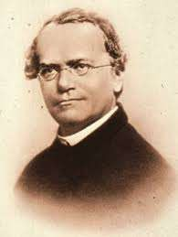
Father of Genetics Gregor Johann Mendel (1822-1884)
Austrian monk
Born in 1822 near Brunn in Austria, in
a poor family.
Studied the inheritance of traits in the
garden pea
Published his theory in 1866
“Experiments on Plant Hybrids”
In 1900, the work of Mendel was
independently rediscovered by
Hugo de Vries (Holland)
Carl Correns (Germeny)
Erich Tschermak (Austria).

Slide 15
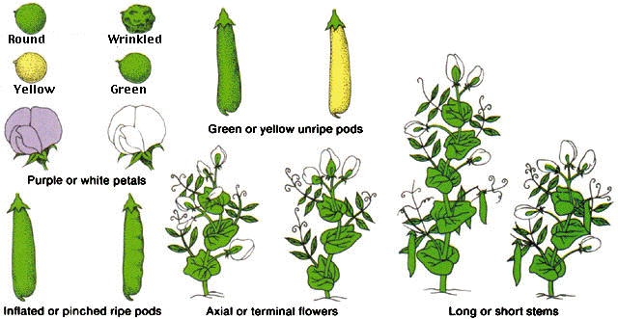
Mendel’s peas
Mendel looked at seven traits or characteristics of pea plants:

