Slide 1

Dr.Umayal Ramanathan College for Women
Accredited with B+ Grade by NAAC
Affiliated to Alagappa University
(Run by Dr.Alagappa Educational Trust)
Karaikudi – 630 003
Name of the Faculty: V.Seethalakshmi
Department: COMMERCE WITH COMPUTER APPLICATION

Slide 2
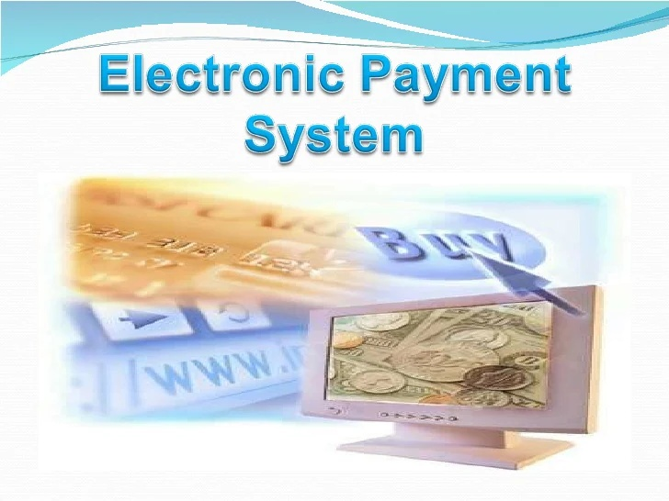
ELECTRONIC PAYMENT SYSTEM

Slide 3
Commerce
Commerce: Exchange of Goods / Services
Contracting parties: Buyer and Seller
Fundamental principles: Trust and Security
Intermediaries:
    Direct (Distributors, Retailers)
    Indirect (Banks, Regulators)
Money is a medium to facilitate transactions
Attributes of money:
  Acceptability, Portability, Divisibility
  Security, Anonymity
  Durability, Interoperability

Slide 4
E-Commerce
Automation of commercial transactions using computer and communication technologies
Facilitated by Internet and WWW
Business-to-Business: EDI
Business-to-Consumer: WWW retailing
Some features:
  Easy, global access, 24 hour availability
  Customized products and services
  Back Office integration
  Additional revenue stream

Slide 5
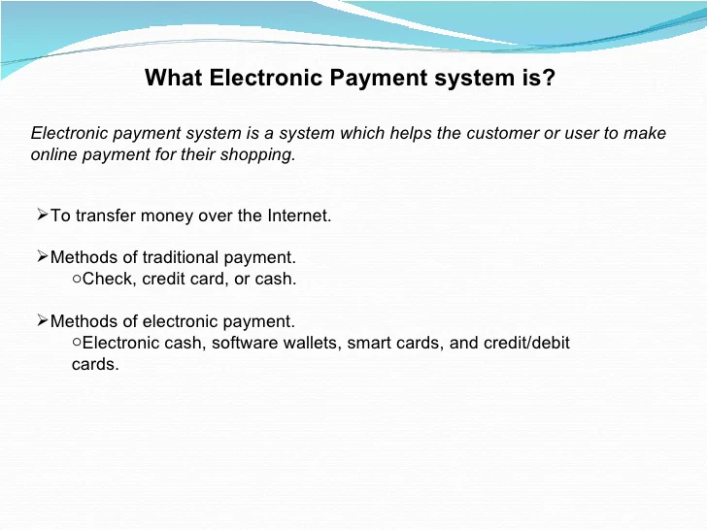

Slide 6
Payment system types
Credit card-based methods
  Credit card over SSL - First Virtual -SET
Electronic Cheques
  - NetCheque
Anonymous payments
  - Digicash - CAFE
Micropayments
SmartCards

Slide 7
Store value card [Smart card]
Payment Card [Credit and Debit Card]
Methods Of E-Payment
Electronic or Digital Cash
Store value card [Smart card]
Electronic or Digital Wallet

Slide 8
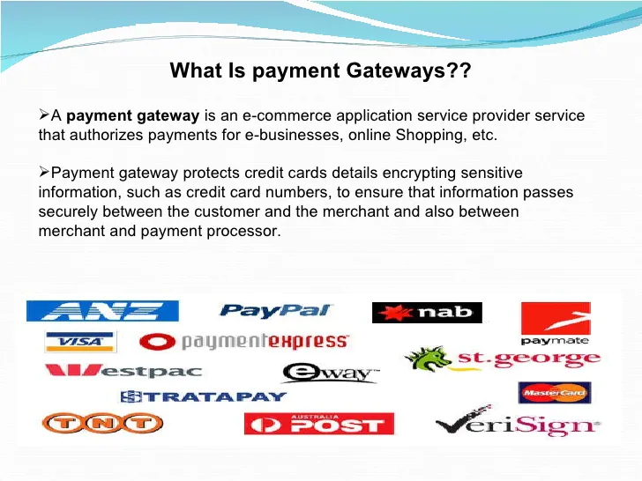

Slide 9
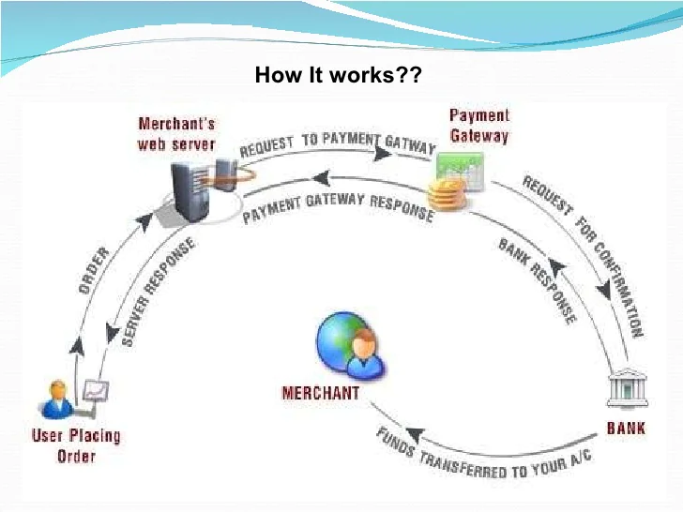

Slide 10
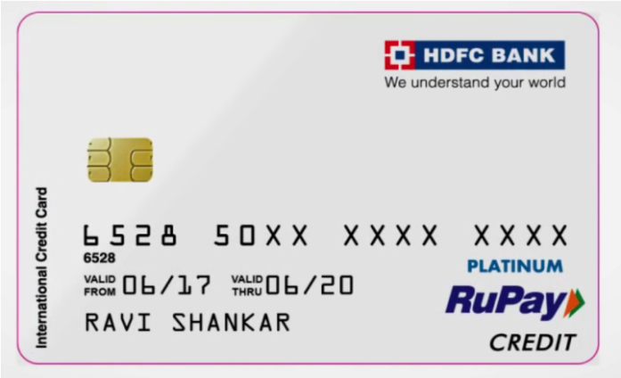
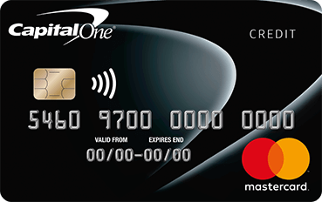
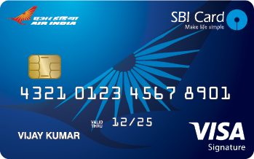
1. Payment Card [Credit and Debit Card]
a) Credit Card:-
Credit card are very commonly used as a tool for electronic payment.
It is a thin plastic card that can be used to buy items, meet food or restaurant bills, booking of airline tickets etc. Any credit card allows a user to pay later for the items one has bought or the services availed, hence the name credit card is given. This process of payment is known as charging. Charging means that one user had paid for the items his or her credit card by promising to pay when the user had signed the credit card receipt. Credit card are normally issued from a bank or any authorized authority.

Slide 11
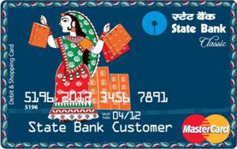
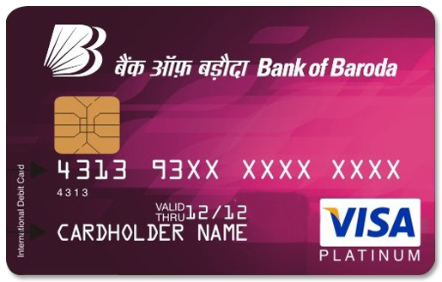
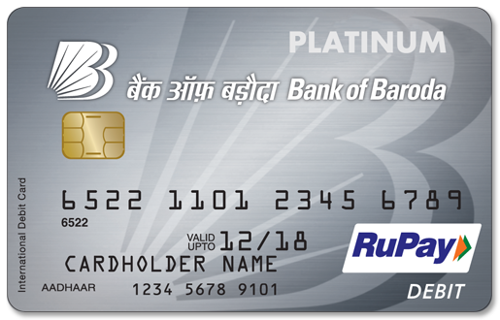
1. Payment Card [Credit and Debit Card]
b) Debit Card:-
A debit card (also known as a bank card, plastic card or check card) is a plastic payment card, that can be used instead of cash when making purchases. It is similar to a Credit card, but unlike a credit card, the money comes directly from the user's bank account, when performing a transaction.
Payments using a debit card are immediately transferred from the cardholder's designated bank account, only if sufficient balance is available, If not the transaction will be failed.
Debit cards usually also allow for instant withdrawal of cash, acting as an ATM card for withdrawing cash.

Slide 12
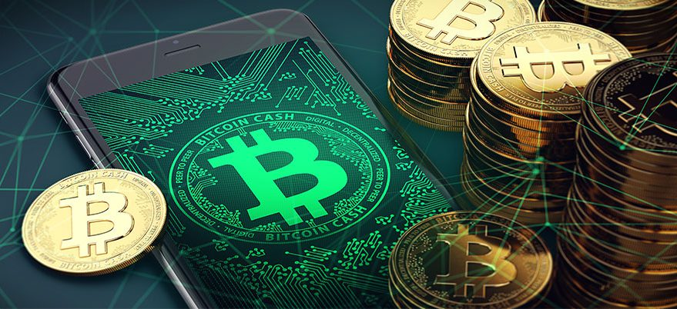
2. Electronic or Digital Cash
Digital cash refers to a format of electronic data that is similar in functions like that of our traditional paper cash. Digital cash can be stored, Transferred , paid and verified electronically through the use of different digital devices such as Computers, Mobile phones etc.

Slide 13
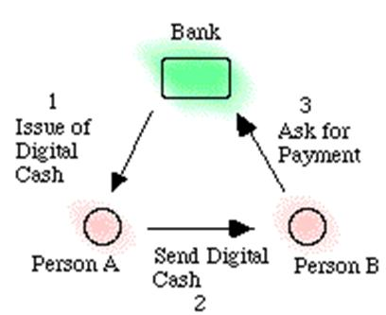
2. Electronic or Digital Cash
Points to remember-
Like traditional paper cash, the model of digital cash also involves three parties- Customer, Trader and Bank.
The digital cash can not be manipulated and refused by a user illegally.
Digital cash ensures privacy or untraceability.
The digital cash can be transferred between different customer without involvement of the bank before finally deposited into the customer’s bank A/c
Trader can verify the validity of e cash without involvement of the bank.
Without the bank’s interference, a user can subdivide an amount of e-cash in a given amount into smaller subdivisions of e-cash.
the security of e-cash does not depend on any physical or geographical locations or special devices.

Slide 14
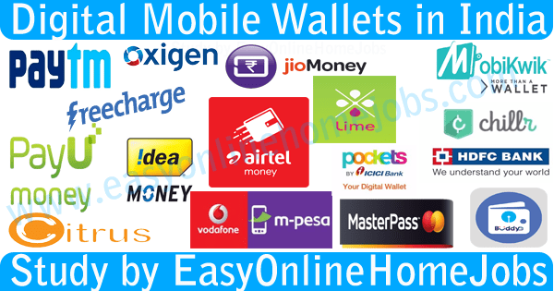
3. Electronic or Digital wallet
An electronic wallet or E-wallet is defined as an encrypted medium for storage or holding credit card and other confidential financial information that can be used to complete electronic transactions without re-entering the stored data at the time of transaction itself. Access to E-wallet requires password or “keys”.

Slide 15
3. Electronic or Digital wallet
Functions of Digital wallet
Managing of one’s payment and accounts.
Getting of offers from traders one knows and can depend upon.
Storage of digital receipts and warranty information.
Getting of alerts about one’s account and one’s spending.
Security issues associated with Digital wallets
Providing protection through password as well as providing physical protection to the devices which are to be used to access the payment options such as PC, mobile phones, laptops, tablets etc.
Only the owner can access sensitive information such as including User name, password, PINs and answers to security options.

Slide 16
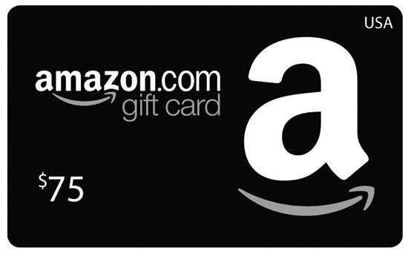
4. Stored value Card (Smart card)
A stored-value card is a payments card with a monetary value stored on the card itself, not in an external account maintained by a financial institution. Stored-value cards differ from debit cards, where money is on deposit with the issuer, and credit cards which are subject to credit limits set by the issuer. Another difference between stored-value cards and debit and credit cards is that debit and credit cards are usually issued in the name of individual account holders, while stored-value cards may be anonymous, as in the case of gift cards. Stored-value cards are prepaid money cards and may be disposed when the value is used, or the card value may be topped up, as in the case of telephone calling cards or when used as a fare cards.
Like Amazon gift card, Metro ticket cards, Big bazar cards.
These cards are two type-
Closed loop Stored value Card .
Open Loop Stored value Card .

Slide 17
5. E - Money
Electronic money is money which exists in banking computer systems and is available for transactions through electronic systems. Its value is backed by fiat currency and it can be exchanged into physical form however its uses are often more convenient electronically.
E – Money in India
At the end of May 2017, Paytm – India’s largest mobile money company – launched Paytm Payments Bank, having received the last clearance from the Reserve Bank of India (RBI). “We wish to acquire 500 million new customers and launch a slew of financial services products such as deposits, wealth management, insurance, financial lending and many more,”
E- money is therefore not a result of demonetization, but it has taken off following the controversial move by the Indian government to remove Rs500 and Rs1,000 notes from circulation. Prevention of corruption and the spread of black money, choking terror funding, and the creation of a cashless society were the main objectives of the demonetization measure.

Slide 18
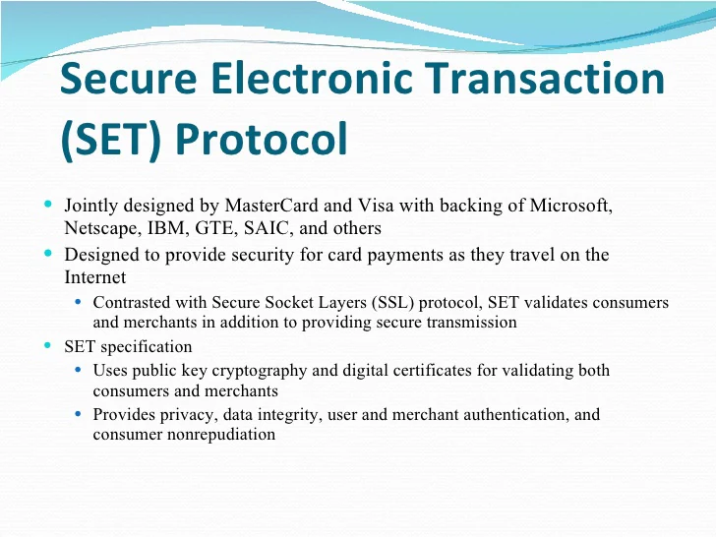

Slide 19
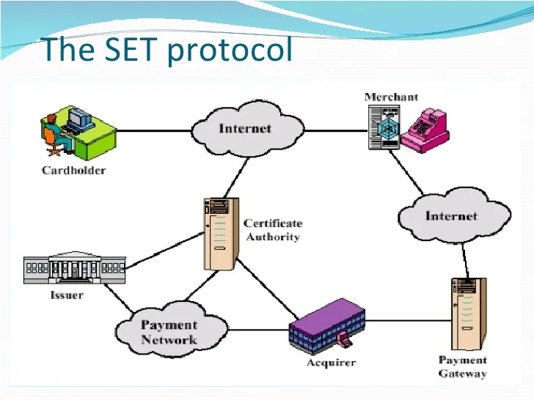

Slide 20
                THANK YOU

